Slide 1
Software Engineering: 4. Quality
Romi Satria Wahono romi@romisatriawahono.net http://romisatriawahono.net/se WA/SMS: +6281586220090

Slide 2
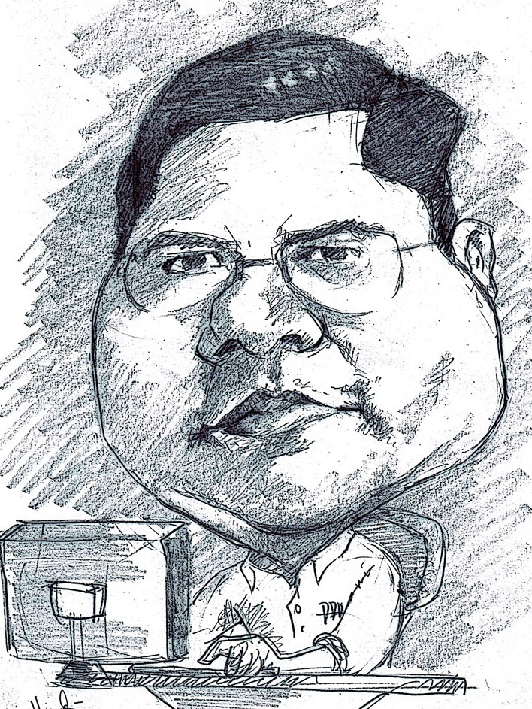
Romi Satria Wahono
SD Sompok Semarang (1987)
SMPN 8 Semarang (1990)
SMA Taruna Nusantara Magelang (1993)
B.Eng, M.Eng and Ph.D in Software Engineering from Saitama University Japan (1994-2004) Universiti Teknikal Malaysia Melaka (2014)
Research Interests: Software Engineering, Machine Learning
Founder dan Koordinator IlmuKomputer.Com
Peneliti LIPI (2004-2007)
Founder dan CEO PT Brainmatics Cipta Informatika

Slide 3
Course Outline
1. Introduction
2. Process
4. Quality
5. Research
3. Methodology

Slide 4
4. Quality
4.1 Software Quality
4.2 Software Quality Metrics

Slide 5
4.1 Software Quality

Slide 6
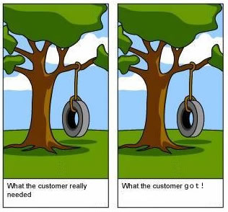
Definisi dari Sofware Quality
Software quality is (IEEE, 1991):
The degree to which a system, component, or process meets specified requirements
The degree to which a system, component, or process meets customer or user needs or expectations
Software quality measures how well software is designed (quality of design), and how well the software conforms to that design (quality of conformance) (Pressman, 2014)
Quality means conformance to requirements (Crosby, 1979)

Slide 7
Quality Concepts
Design
Quality of Design
Development
Quality of Conformance
Testing
Quality Control
the characteristics that designer’s specify for an item
the degree to which the design specifications are followed during manufacturing
the series of inspections used throughout the development cycle to ensure that each work product meets the requirements

Slide 8
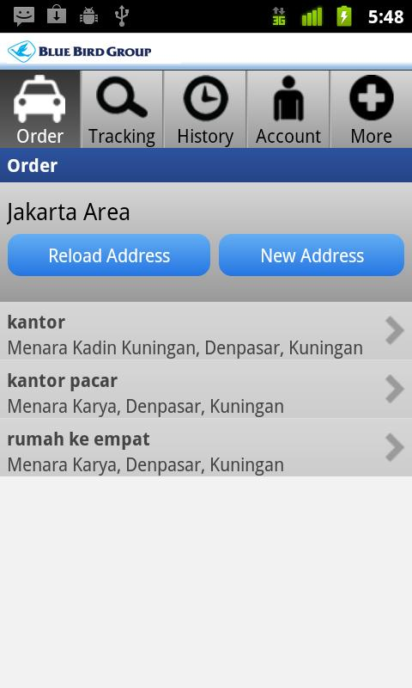
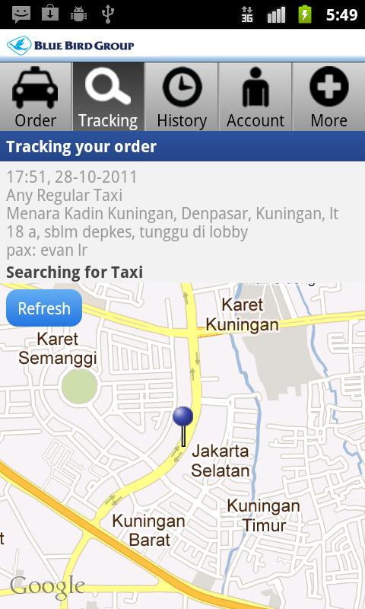
Software untuk Pesan Taxi

Slide 9
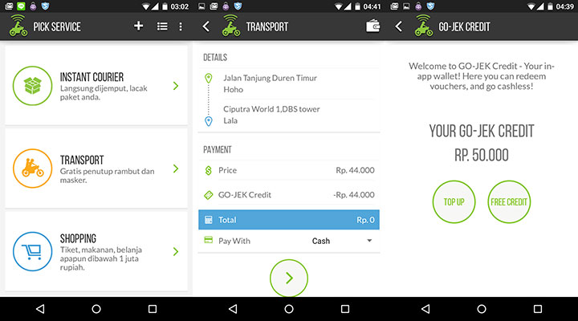
Software untuk Pesan Ojek (Go-Jek)

Slide 10

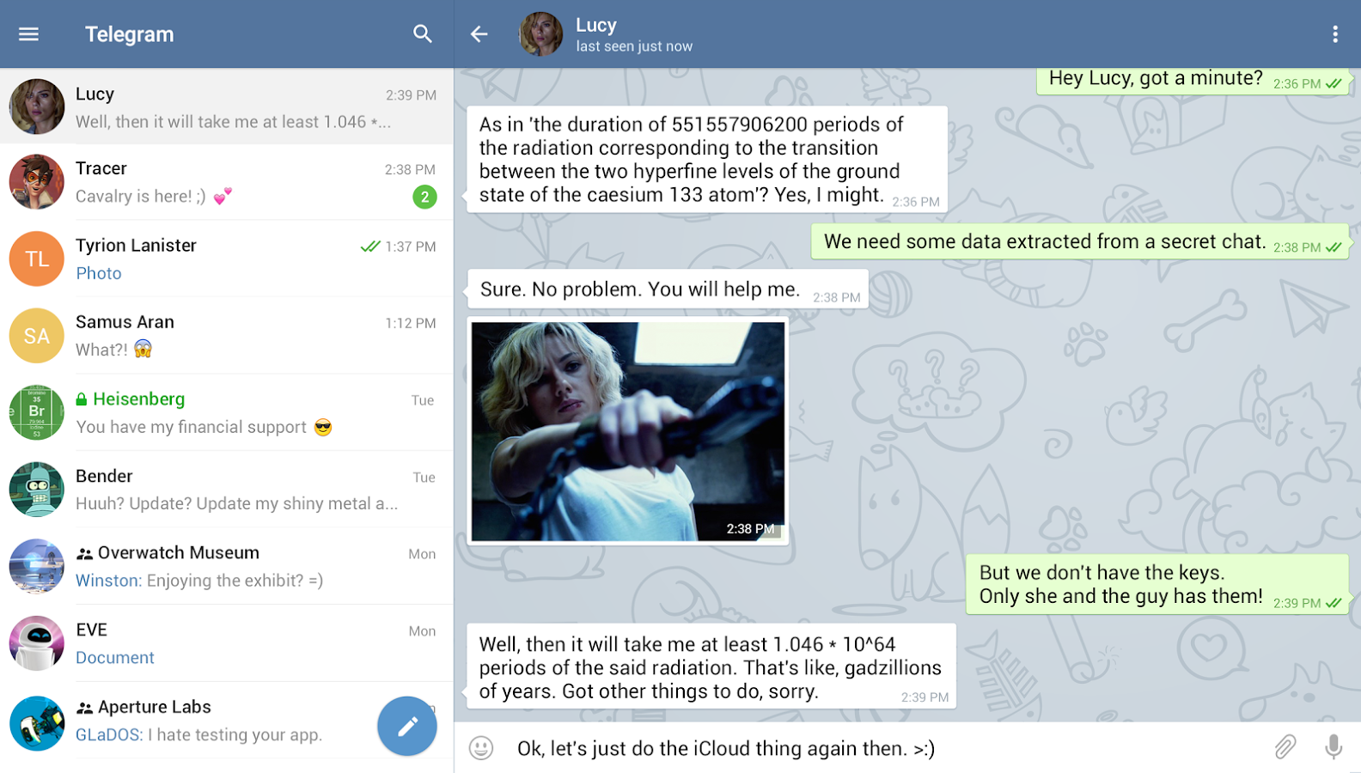

Slide 11

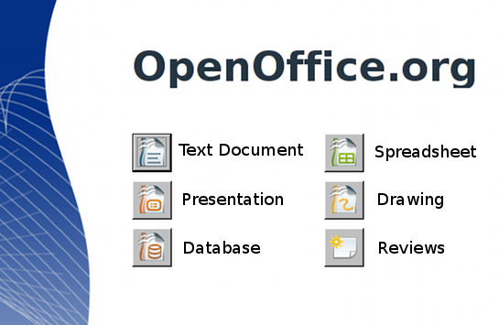
Software Office

Slide 12
Latihan Analisis Kasus
Ingat kembali handphone android/bb/iphone anda
Aplikasi apa yang didalamnya yang anda pikir sangat bermanfaat dan sesuai dengan kebutuhan anda?

Slide 13
4.2 Software Quality Metrics

Slide 14
Software Quality Metrics
Software
Quality
Product (mengukur software dari kualitas produk jadinya)
McCall
ISO 9126
Process (mengukur software dari kematangan proses pengembangannya)
CMMI
ISO 9001
Boehm
Lean Six Sigma

Slide 15
4.2.1 Product Aspect

Slide 16
McCall’s Factor Model
McCall’s factor model classifies all software requirements into 11 quality factors and 23 quality criteria
The 11 factors are grouped into three categories:
Product operation factors: Correctness, Reliability, Efficiency, Integrity, Usability
Product revision factors: Maintainability, Flexibility, Testability
Product transition factors: Portability, Reusability, Interoperability

Slide 17
McCall’s Factor Model
Quality Factor | Quality Criteria
Correctness |  | Completeness, Consistency, Traceability
Reliability |  | Accuracy, Error Tolerance, Consistency, Simplicity
Efficiency |  | Execution Efficiently, Storage Efficiency
Integrity |  | Access Control, Access Audit
Usability |  | Communicativeness, Operability, Training
Maintainability |  | Consistency, Conciseness, Simplicity, Modularity, Self-documentation
Testability |  | Simplicity, Modularity, Instrumentation, Self-documentation
Flexibility |  | Expandability, Generality, Modularity, Self-documentation
Portability |  | Software/Hardware Independence, Self-documentation, Modularity
Reusability |  | Generality, Software/Hardware Independence, Modularity
Interoperability |  | Communication Commonality, Data Commonality, Modularity

Slide 18
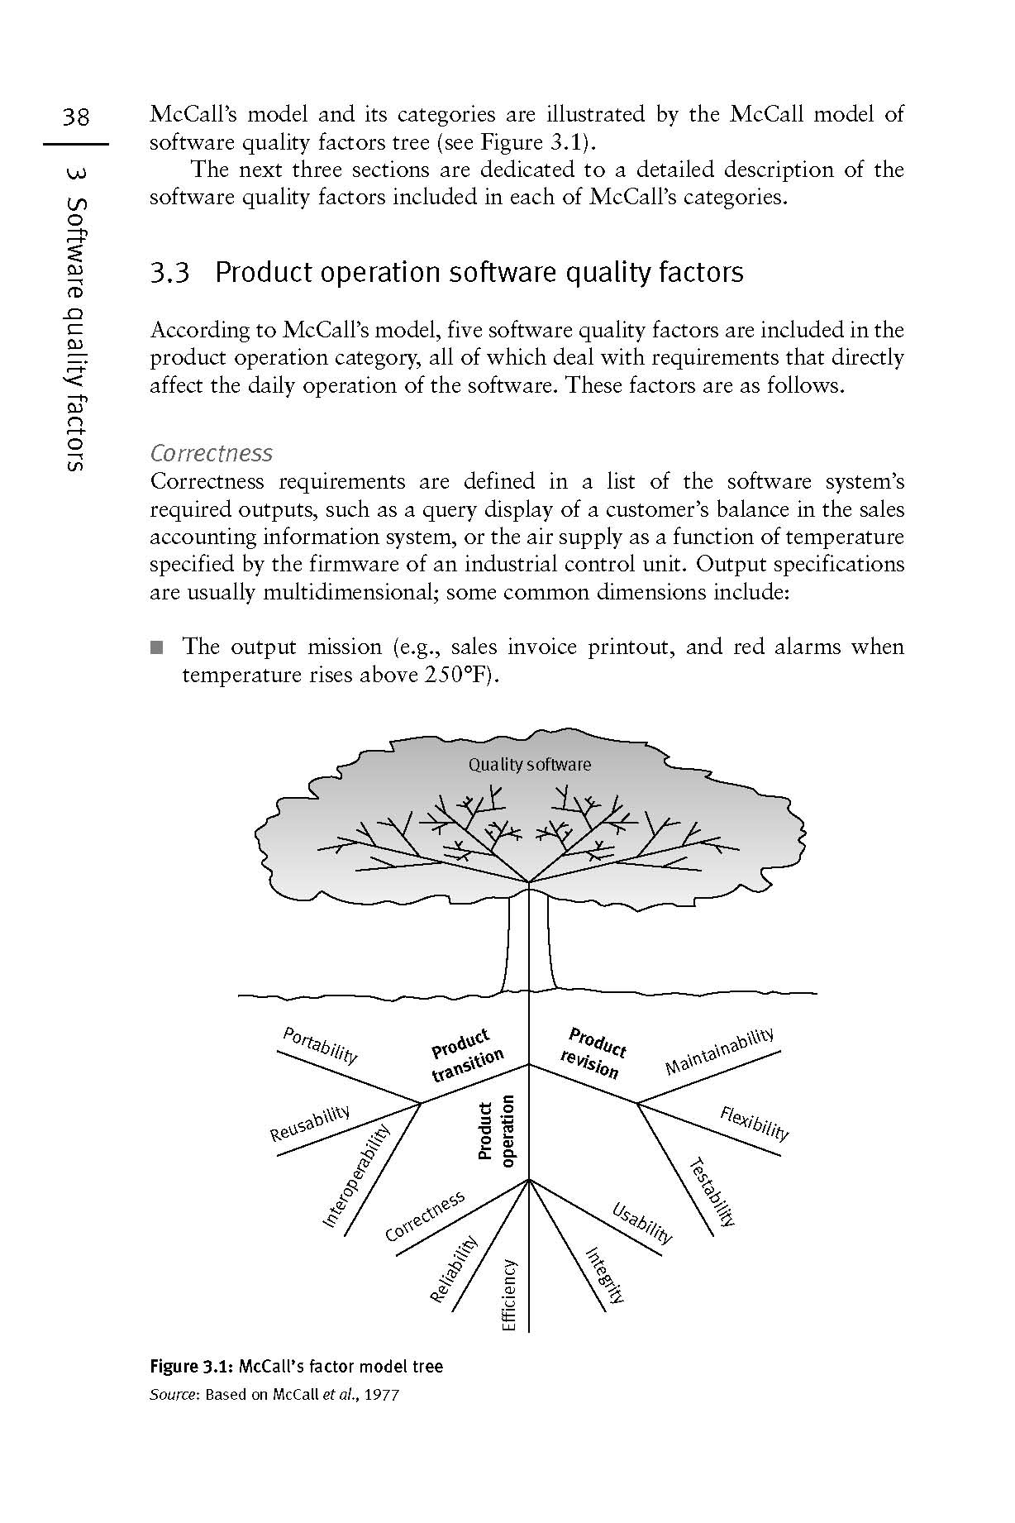

Slide 19
Evans and Marciniak vs Deutsch and Willis Factor Models
The two factor models from the late 1980s, alternatives to the McCall classic factor model:
The Evans and Marciniak factor model
The Deutsch and Willis factor model
These alternative models suggest adding five factors to McCall’s model
Two of these factors are very similar to two of McCall’s factors; only three factors are “new”:
Both models add the factor Verifiability
The Deutsch and Willis model adds the factors Safety and Manageability

Slide 20
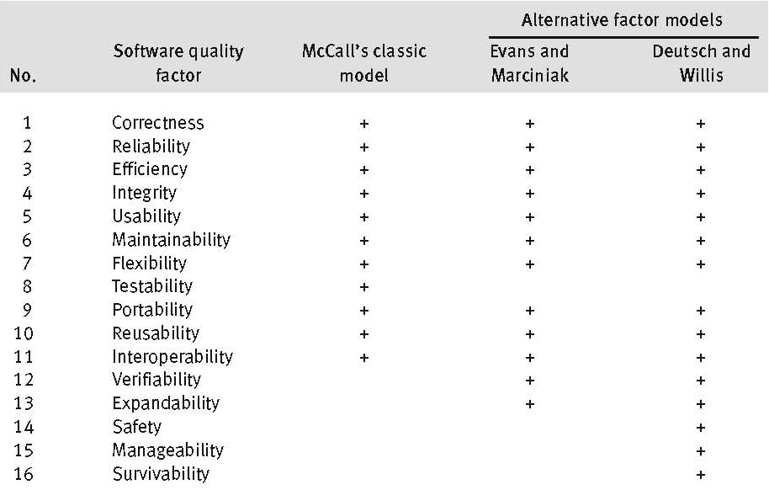

Slide 21
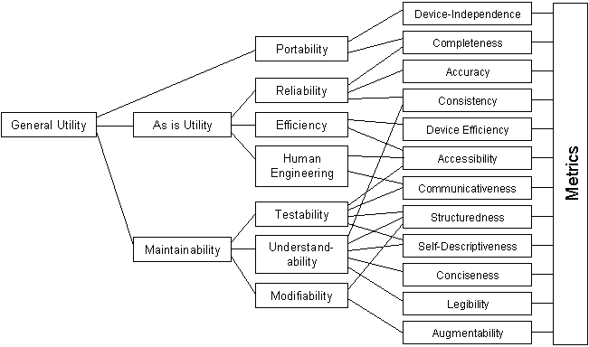
Boehm Factor Model (1978)
Boehm has defined 3 level of quality attributes:
Primary Uses
Intermediate constructs
Primitive constructs
Intermediate Constructs:
Portability
Reliability
Efficiency
Usability
Testability
Understandibility
Flexibility
Primary Uses
Intermediate Constructs
Primitive Constructs

Slide 22
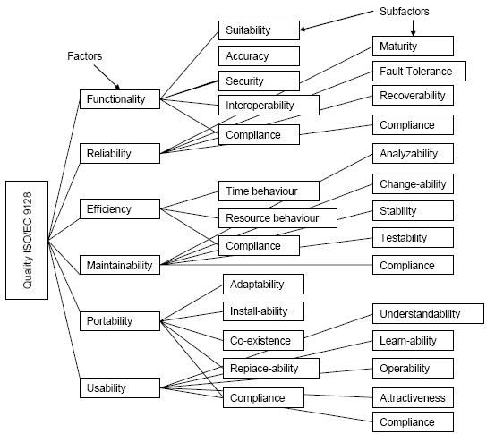
ISO 9126 Factor Model
Functionality
Reliability
Usability
Efficiency
Maintainability
Portability

Slide 23
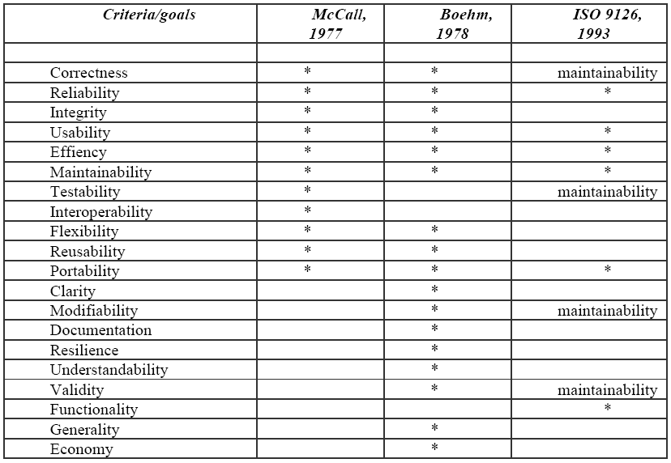
Mc Call vs Boehm vs ISO 9126

Slide 24
Contoh Pengukuran Product
Fa = w1c1 + w2c2 + … + wncn
F= Factor, W= Weight, C=Criteria
http://romisatriawahono.net/2006/06/05/teknik-pengukuran-kualitas-perangkat-lunak/

Slide 25
4.2.2 Process Aspect

Slide 26
Capability Maturity Model Integration (CMMI)
CMMI adalah kerangka kerja (framework) yang bisa digunakan untuk mengembangkan proses di dalam perusahaan
Apa itu proses? Proses adalah cara kita melakukan suatu tugas
Misalnya, membuat proposal, menganalisa kebutuhan client, membuat kode program, dan kegiatan lainnya
Semua tata laksana kegiatan tersebut dikenal dengan nama proses atau prosedur
CMMI membantu kita untuk memperbaiki proses di perusahaan/organisasi kita. Dengan membaiknya proses, diharapkan produk yang dihasilkan akan ikut menjadi baik

Slide 27
Capability Maturity Model Integration (CMMI)
Level 1 – Initial tanpa prosedur dan planning, tidak konsisten
Level 2 – Repeatable ada manajemen, jaminan kualitas, prosedur, individual performance tanpa model formal
Level 3 – Defined proses terdefinisi, dan mengarah ke perbaikan proses secara kualitatif
Level 4 – Managed perbaikan dan prediksi proses secara kuantitatif
Level 5 – Optimizing memperbaiki proses secara berkesinambungan, inovatif, direncanakan, dianggarkan dan integral dalam proses organisasi

Slide 28
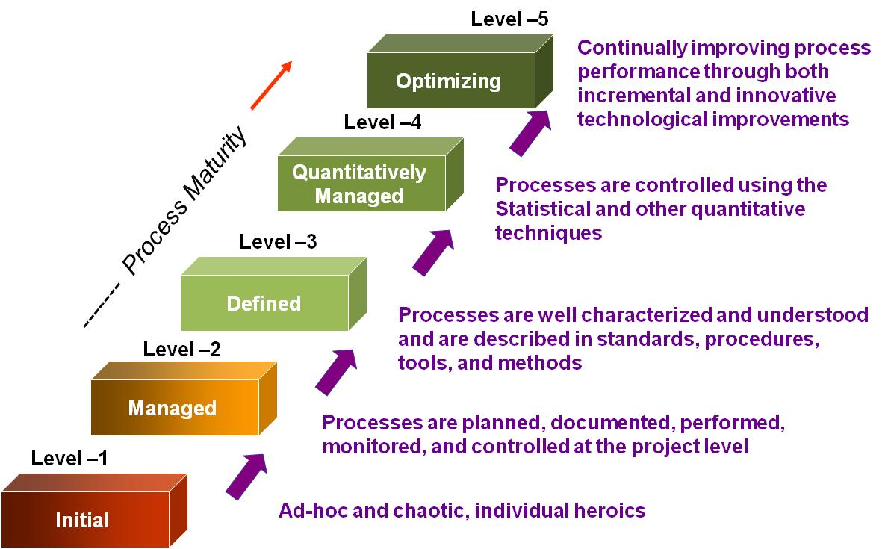
Capability Maturity Model Integration (CMMI)

Slide 29
Lean Six Sigma
Lean Six Sigma (LSS) is a powerful approach to improving the work we do
LSS improvement projects are performed by teams
Teams use a set of tools and techniques to understand problems and find solutions
Lean Six Sigma integrates tools and techniques from two proven process improvement methods

Slide 30
What is Six Sigma?
Six Sigma is a management philosophy based on meeting business objectives by reducing variation
A disciplined, data-driven methodology for decision making and process improvement
To increase process performance, you have to decrease variation
Too early
Too late
Too early
Too late
Greater predictability in the process
Less waste and rework, which lowers costs
Products and services that perform better and last longer
Happier customers
Defects
Defects
Reduce
Delivery Time
variation
Delivery Time
Spread of variation too wide compared to specifications
Spread of variation narrow compared to specifications

Slide 31
A General Purpose Problem-Solving Methodology: DMAIC
Problem or goal statement (Y)
Define
Measure
Analyze
Improve
Control
Refine problem & goal statements.
Define project scope & boundaries.
An improvement journey to achieve goals and resolve problems by discovering and understanding relationships between process inputs and outputs, such as
Y = f(defect profile, yield)
= f(review rate, method, complexity……)
Notes:
Roots
Plan-Do-Check-Act
Creative problem-solving literature
Total Quality Management
Six Sigma
As the animations on this slide appear:
we are faced with many problems, such as……
in the first step of our methodology, define, we focus on refining the problem statements and establishing the scope of the improvement project at hand
the remaining steps, measure-analyze-improve-control, are often iterative and involve a “peeling of the onion” -- an evolution through a discovery phase, to understanding, to improvement and finally to final performance
the ultimate goal is to be able to characterize performance (the Ys) in terms of process factors that are controllable

Slide 32
Latihan Kognitif
Jelaskan bagaimana cara mengukur kualitas software!
Jelaskan level dari CMMI?

Slide 33
Latihan Analisis Kasus
PT ABC adalah sebuah perusahaan pengembang software yang memiliki manajemen yang sudah baik beserta berbagai prosedur baku untuk menjalankan prosesnya
Perusahaan tersebut juga memiliki jaminan kualitas terhadap produk yang dikembangkan
Akan tetapi masih mengandalkan 1-2 orang programmernya untuk memproduksi software dengan kualitas yang baik
Masuk di CMMI level berapakah PT ABC tersebut?

Slide 34
Reference (Foundation)
Ian Sommerville, Software Engineering 10th Edition, Addison-Wesley, 2015
Roger S. Pressman, Software Engineering: A Practitioner’s Approach 8th Edition, McGraw-Hill, 2014
P. Bourque and R.E. Fairley, eds., Guide to the Software Engineering Body of Knowledge Version 3.0, IEEE Computer Society, 2014
Albert Endres dan Dieter Rombach, A Handbook of Software and Systems Engineering, Pearson Education Limited, 2003
Yingxu Wang, Software Engineering Foundations: A Software Science Perspective, Auerbach Publications, Taylor & Francis Group, 2008

Slide 35
Reference (Process)
Alan Dennis et al, Systems Analysis and Design with UML – 4th Edition, John Wiley and Sons, 2012
Dan Pilone and Russ Miles, Head First Software Development, O’Reilly Media, 2008
Barclay and Savage, Object-Oriented Design with UML and Java, Elsevier, 2004
Kenneth E. Kendall and Julie E Kendall, Systems Analysis and Design 8th Edition, Prentice Hall, 2010
Hassan Gomaa, Software Modeling and Design: UML, Use Cases, Patterns, and Software Architectures, Cambridge University Press, 2011
Layna Fischer (edt.), BPMN 2.0 Handbook Second Edition, Future Strategies, 2012

Slide 36
Reference (Quality)
Daniel Galin, Software Quality Assurance, Addison-Wesley, 2004
Kshirasagar Naik and Priyadarshi Tripathy, Software Testing and Quality Assurance, John Wiley & Sons, Inc., 2008
Jeff Tian, Software Quality Engineering, John Wiley & Sons, Inc., 2005
G. Gordon Schulmeyer, Handbook of Software Quality Assurance Fourth Edition, Artech House, 2008

Slide 37
Reference (Research)
Christian W. Dawson, Project in Computing and Information System a Student Guide 2nd Edition, Addison-Wesley, 2009
Mikael Berndtsson, Jörgen Hansson, Björn Olsson, Björn Lundell, Thesis Projects - A Guide for Students in Computer Science and Information System 2nd Edition, Springer-Verlag London Limited, 2008
Mary Shaw, Writing Good Software Engineering Research Papers, Proceedings of the 25th International Conference on Software Engineering, 2003
C. Wohlin, P. Runeson, M. Host, M. C. Ohlsson, B. Regnell, and A. Wesslen, Experimentation in Software Engineering, Springer, 2012
P. Runeson, M. Host, A. Rainer, and B. Regnell, Case Study Research in Software Engineering: Guiidelines and Examples, John Wiley & Sons, Inc., 2012

